Slide 1
ANALYSIS AND DESIGN
MENU
ANALYSIS
CONTACT
REQUIREMENTS
Member
Nguyễn Trung Nam 519H0321
Phạm Ngọc Tuân 519H0358

Slide 2
CONTENTS OF THIS TEMPLATE
MENU
ANALYSIS
CONTACT
Data ANALYSIS
Here’s what you’ll find in this template:
Executive Summary
Business Requirements
System Requirements Analysis
System Requirements Design
System Requirements Implementation
System Testing, Deployment and Demonstration

Slide 3
table of contents
MENU
ANALYSIS
CONTACT
business requirements
introduction
i
ii
system requirements analysis
system requirements design
iv
iii
v
vi
system testing, deployment and demonstration
system requirements implementation

Slide 4
introduction
i
MENU
ANALYSIS
CONTACT
Data ANALYSIS

Slide 5

MENU
ANALYSIS
CONTACT
Data ANALYSIS
executive summary
The purpose of the system is to provide an information system for a distributor selling electronics devices products to authorized resellers/agents. The system aims to automate various processes such as goods receiving, warehousing, order processing, and delivery to enhance the efficiency and accuracy of the distributor's operations. Additionally, the system provides features for agents to place orders and make payments, and for accountants to generate reports on inventory movement, revenue, and best-selling products. Ultimately, the system aims to improve the distributor's overall business performance and provide a seamless experience for its agents and customers.

Slide 6
business requirements
ii
MENU
ANALYSIS
CONTACT
Data ANALYSIS

Slide 7
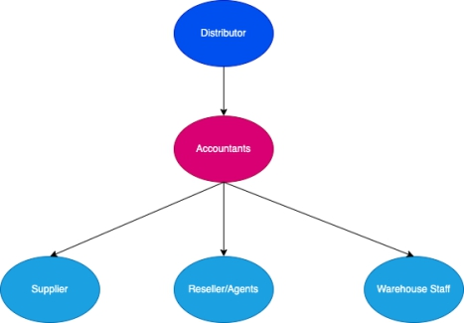
MENU
ANALYSIS
CONTACT
Data ANALYSIS
2.1 Organization Chart / Project Chart/Gantt Chart
Figure 1: Org Chart

Slide 8
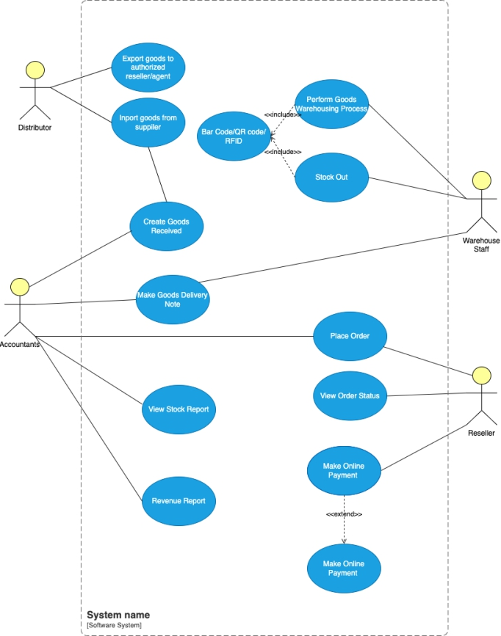
1.1 Business Modelling / Requirements
MENU
ANALYSIS
CONTACT
Data ANALYSIS
2.2 Business Modelling / Requirements

Slide 9
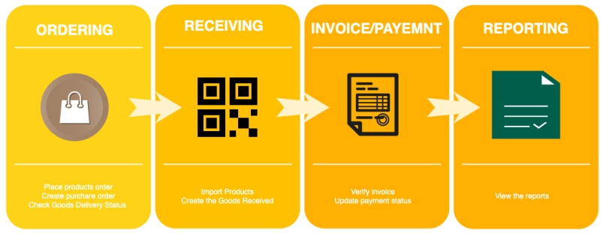
MENU
ANALYSIS
CONTACT
Data ANALYSIS
2.3 Business Processes / Flowchart of Requirements

Slide 10
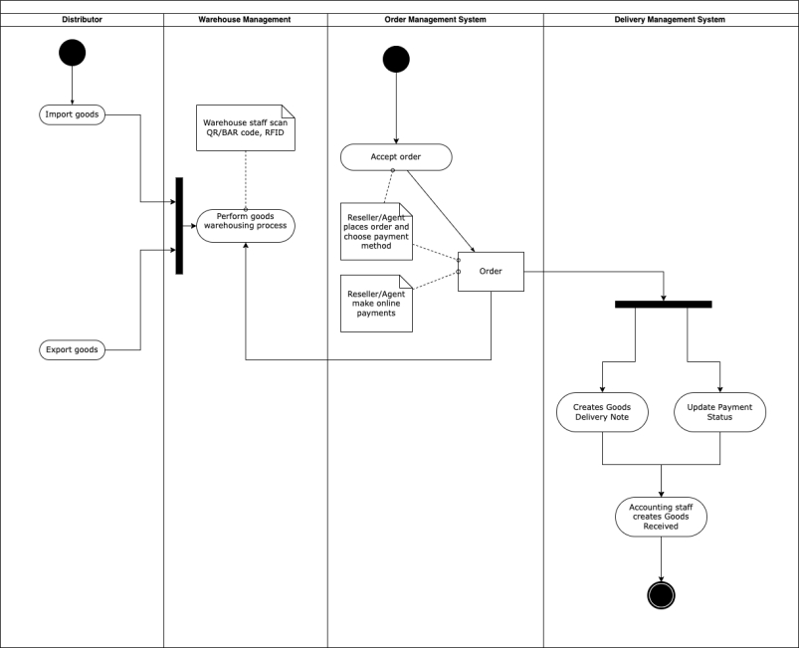
2.4 Activity Diagram

Slide 11
1.1 List of Requirements
Requirements | Funtional | Nonfunctional
The system should allow accountants to create Goods Received when the distributor imports goods, which will include many items. | X
The system should allow warehouse staff to scan barcode/QR Code, RIFDs to perform the goods warehousing process when receiving goods at the warehouse. | X
The system should allow warehouse staff to Reseller/Agents should be able to place an order of items by themselves and choose a payment method (Cash, bank transfer, Momo, etc.).can barcode/QR Code, RIFDs to perform the goods warehousing process when receiving goods at the warehouse. | X
Reseller/Agents should also be able to make an online payment and see the status of their orders. |  | X
The system should allow accounting staff to make Goods Delivery Note, which will be based on previously placed orders, to deliver goods to agents and print delivery slips. | X
The system should update the status of orders as being transferred and update the payment status of agents. | X
The system should allow warehouse staff to make use of barcode/QR Code/RFID for stock out. | X
Accountants should be able to view incoming/outgoing stock report (inventory movement), best-selling products, and revenue report monthly. |  | X

Slide 12
system requirements analysis
iii
MENU
ANALYSIS
CONTACT
Data ANALYSIS

Slide 13
3.1 Translate from Business Use Case
3.1.1. System Narrative
The system will be designed to meet the needs of a distributor selling electronics devices products to authorized reseller/agents. The system will have the following features:
1. Goods Received: The system will allow accountants to create Goods Received when the distributor imports goods. The system will generate a warehouse receipt that includes many items. When the goods are received at the warehouse, warehouse staff will scan the barcode/QR Code, RIFDs to perform the goods warehousing process.
2. Reseller/Agents Orders: Reseller/Agents will be able to place an order of items by themselves and choose a payment method (Cash, bank transfer, Momo...). They will also be able to make an online payment and see the status of their orders.
3. Goods Delivery Note: The system will allow accounting staff to make Goods Delivery Note based on previously placed orders to deliver goods to agents. They can print delivery slips, update the status of orders as being transferred and update the payment status of agents.
4. Barcode/QR Code/RFID for stock out: The system will allow warehouse staff to make use of barcode/QR Code/RFID for stock out.
5. Reports: The system will allow accountants to view incoming/outgoing stock report (inventory movement), best-selling products and revenue report monthly.

Slide 14
3.1.2. Users and their goals
USER/ACTOR | USER GOAL
Accountants | Manage the inventory of goodsCreate Goods Received when the distributor imports goodsView incoming/outgoing stock report, best-selling products, and revenue report monthlyMake Goods Delivery NoteUpdate the status of orders as being transferredUpdate the payment status of agents.
Warehouse Staff | Scan barcode/QR Code/RFID to perform the goods warehousing processUse barcode/QR Code/RFID for stock out.
Reseller/Agents | Place an order of itemsChoose a payment methodMake an online paymentSee the status of their orders.
Distributor | Import good from supplierExport goods to authorized reseller/agent

Slide 15
3.1.4. List of Actors
• Accountants - Responsible for creating Goods Received and Delivery Note, updating payment and order status, and viewing stock and revenue reports.
• Warehouse Staff - Responsible for scanning barcode/QR Code/RFIDs to perform the goods warehousing process and stock out process.
• Reseller/Agents - Authorized buyers who can place orders, choose payment methods, make online payments, and track their orders.
• Distributor – Import goods from supplier, Export goods to authorized reseller/agent.

Slide 16
3.1.5. List of Use Cases
Member Registration: Register new member as when new member applies to be a member. Member would initiate this action and serviced by Attendant.

Slide 17
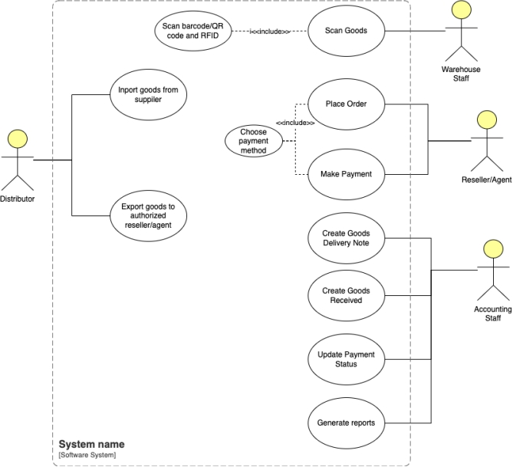
3.1.6. Use Case Diagram

Slide 18
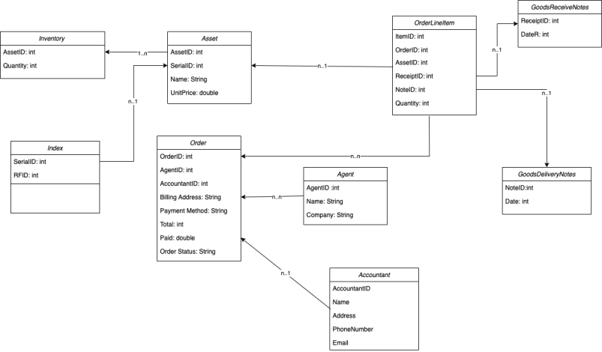
3.1.7. Domain Class Model Diagram
Figure: Customer Account Subsystem Domain Model Class Diagram

Slide 19
3.2 Use Case Descriptions
3.2.1. Use Case: Create Goods Received
i. Use case : name 1 fully description
Use case name: Create Goods Received
Scenario: To create a Goods Received record when the distributor imports goods.
Triggering event: Accountants wants to create good received of import goods
Actors: Accountants
Related use cases: Might be invoked generate reports, scan goods and import goods from supplier.
Preconditions:
• The distributor must have imported goods.
• The Accountant or Warehouse Staff has the necessary permissions to access the system.
Postconditions:
• The Goods Received record is created and stored in the system.
Flow of activities:
1. The accountant accesses the information system and selects the option to create a Goods Received record.
2. The system presents a form for the accountant to fill in the details of the received goods, such as the date of receipt, the supplier, the purchase order number, and a list of items received.
3. The accountant fills in the required details and submits the form.
4. The system validates the input and creates a Goods Received record in the system.
5. The system updates the inventory to reflect the newly received items.
6. The system sends a notification to the warehouse staff to begin the goods warehousing process.
Exception conditions:
• If there is a problem with the information system, such as a system outage or a data loss, the accountant will not be able to create the Goods Received record.

Slide 20
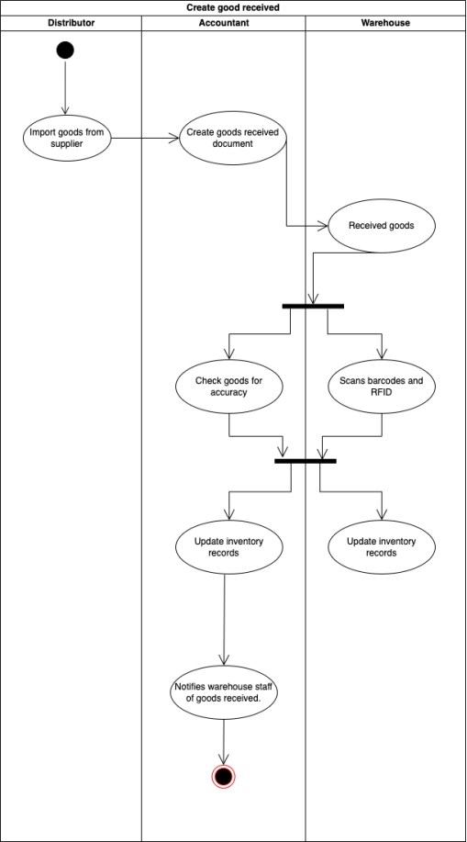
i. Activity diagram for Use Case: Create Goods Received

Slide 21
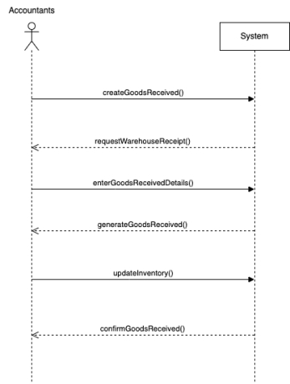
ii. System sequence diagram for Use Case: Create Goods Received

Slide 22
3.2.2. Use Case: Place order
i. Use case : Place order fully description
Use case name: Place order
Scenario: Resller/Agents place order online
Triggering event: The Place Order use case allows Resellers/Agents to place an order for electronics devices products by themselves and choose a payment method. Resellers/Agents would also make an online payment and see the status of their orders.
Actors: Resller/Agents
Related use cases: Might be invoked select payment method, view order status.
Preconditions:
• Reseller/Agent must be authorized to place an order.
• Reseller/Agent must have a valid account in the system.
• The system must have the necessary inventory of electronics devices products.
Flow of activity:
1. Reseller/Agent logs into the system.
2. Reseller/Agent selects the electronics devices products they want to purchase.
3. Reseller/Agent adds the selected products to their cart.
4. Reseller/Agent chooses a payment method (Cash, bank transfer, Momo, etc.).
5. Reseller/Agent confirms the order.
6. The system verifies the payment.
7. If payment is successful, the order is stored in the system and the inventory is updated.
8. Accounting Staff is notified of the new order.

Slide 23
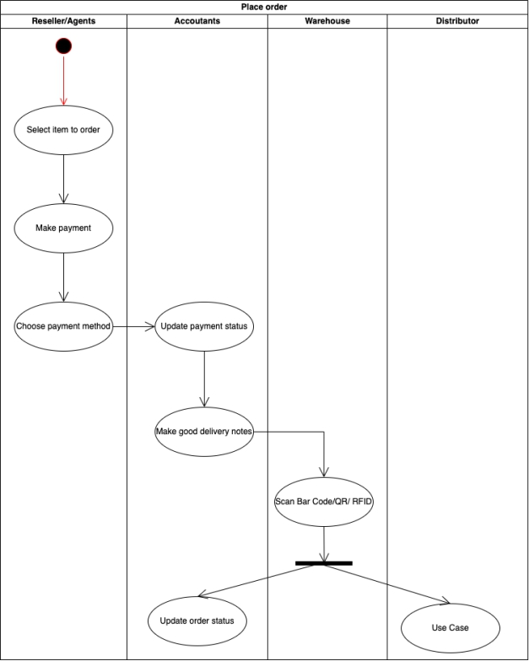
i. Activity diagram for Use Case: Place order
ii. Activity diagram for Use Case: Place order

Slide 24
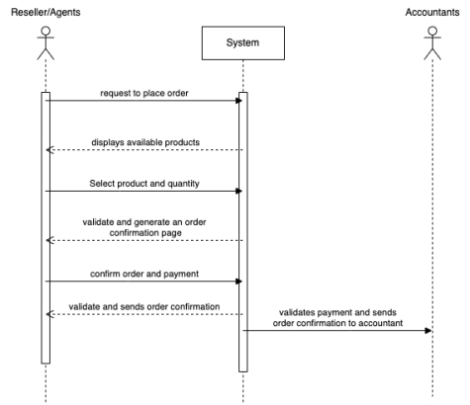
iii. System sequence diagram for Use Case: Place order

Slide 25
3.2.3. Use Case: Perform warehousing proccess
i. Use case : Perform warehousing proccess fully description
Use case name: Perform warehousing proccess
Scenario: Warehouse goods when distributor import goods.
Triggering event: performing the goods warehouse process by the warehouse staff when receiving goods from the distributor. The process includes scanning the barcode/QR code/RFID of the items to be warehoused, verifying the items against the purchase order, and updating the inventory system.
Actors: Warehouse staff
Related use cases: Might be invoked create goods receive notes, scan bar code/QR/RFID
Preconditions:
• The distributor has imported goods to the warehouse.
• The warehouse staff has access to the inventory system.
• The inventory system has been updated with the latest list of items.
Flow of activity:
1. The warehouse staff receives the goods from the distributor.
2. The warehouse staff scans the barcode/QR code/RFID of each item using a scanner device.
3. The system validates the scanned information against the purchase order and confirms the item is part of the order.
4. The warehouse staff confirms the quantity of the item received.
5. The system updates the inventory system with the new stock level of the item.
6. The warehouse staff places the item in the appropriate location in the warehouse.
7. The warehouse staff repeats steps 2-6 for each item in the order.
8. The warehouse staff confirms the successful completion of the process in the inventory system.

Slide 26
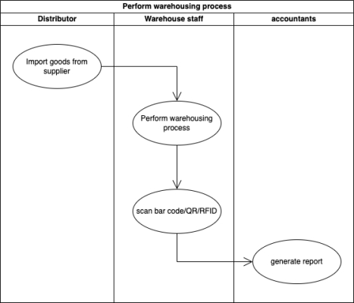
ii. Activity diagram for Use Case: Perform warehousing proccess

Slide 27
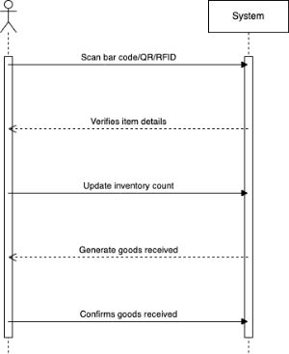
iii. System sequence diagram for Use Case: Perform warehousing proccess

Slide 28
3.2.4. Use Case: Stock out
i. Use case : Stock out fully description
Use case name: Stock out
Scenario: The process of stock out and delivery to authorized reseller/agents
Triggering event: This use case describes the process of stock out, where warehouse staff removes items from inventory and prepares them for delivery to authorized resellers/agents.
Actors: Warehouse staff
Related use cases: Might be invoked create goods delivery notes, scan bar code/QR/RFID
Preconditions:
• The system must have a record of the items available in the inventory.
• The warehouse staff should have the necessary authorization to perform the stock out process.
Flow of activity:
1. The warehouse staff selects the items that need to be removed from the inventory.
2. The staff member scans the barcode/QR code/RFID of the items to confirm that they match the items to be removed.
3. The system updates the inventory by reducing the quantity of the items that are being removed.
4. The staff member prepares the items for delivery to the authorized resellers/agents.
5. The staff member marks the items as "ready for delivery" in the system.
Postconditions:
• The inventory is updated to reflect the removal of the items.
• The items are marked as "ready for delivery" in the system
Exception:
• If there is a system outage during the stock out process, the process will be halted until the system is restored.

Slide 29
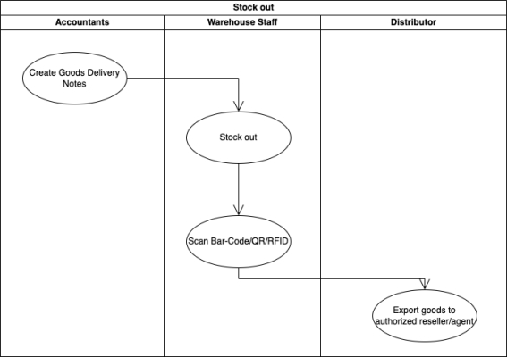
ii. Activity diagram for Use Case: Stock out

Slide 30
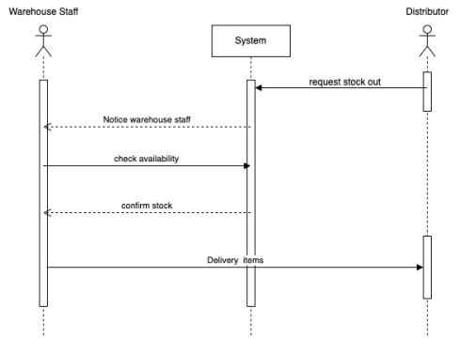
iii. System sequence diagram for Use Case: Stock out

Slide 31
3.3 Verifying use cases for Actor
3.3.1. Verifying uses cases: Create goods Receive for actor Accountants
Data entity/domain class | C R U D | Verified use case
Accountants | Create | Create goods receivedCreate goods delivery notes
 | Update | Update payment method
 | Report | Generate report

Slide 32
3.3.2. Verifying uses cases for Accountants
Data entity/domain class | C R U D | Verified use case
Reseller | Create | Place orderPayment method
 | Read/report | Order status

Slide 33
system requirements design
iv
MENU
ANALYSIS
CONTACT
Data ANALYSIS

Slide 34
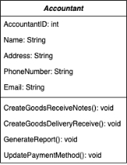
4.1 Design Class for Create good received
4.2.1. Design Classes in Detailed Design

Slide 35
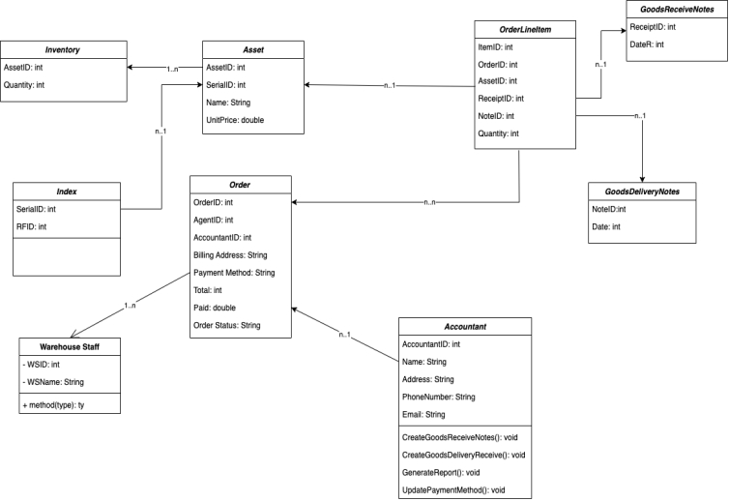
4.2.2. Design Class Diagram
i. Domain Design Class

Slide 36
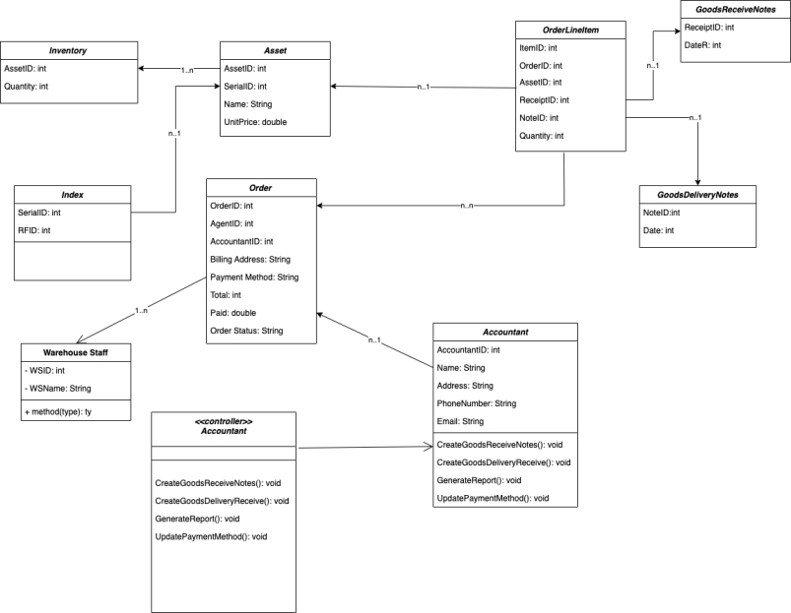
i. Design Class

Slide 37
4.2.3. Final Design Class Diagram

Slide 38
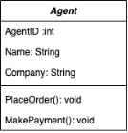
4.2 Design Class for Place Order
4.2.1. Design Classes in Detailed Design

Slide 39
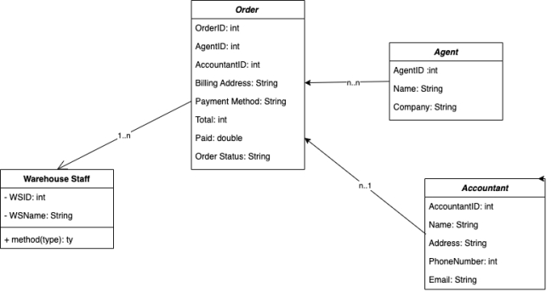
4.2.2. Design Class Diagram
i. Domain Design Class

Slide 40
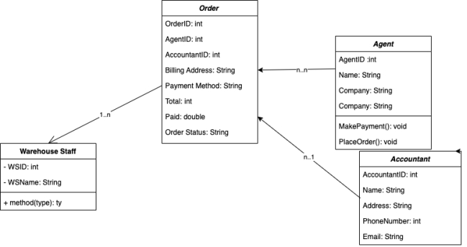
ii. Design Class

Slide 41
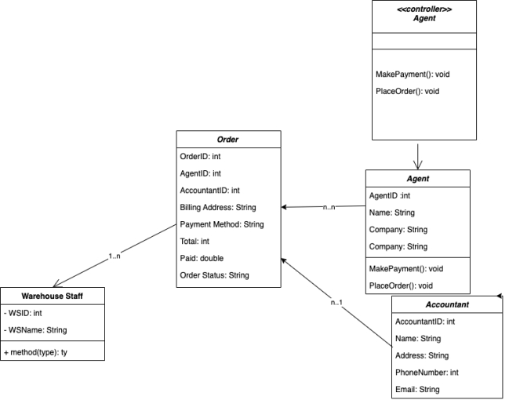
4.2.5. Final Design Class Diagram

Slide 42
system requirements implementation
v
MENU
ANALYSIS
CONTACT
Data ANALYSIS

Slide 43
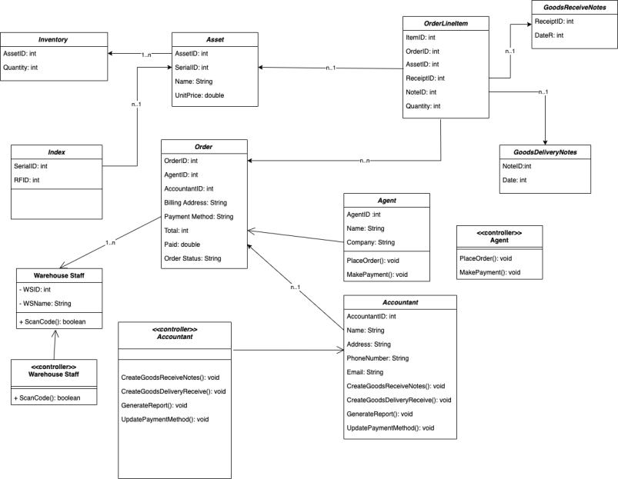
5.1 Design Class for Sub System

Slide 44
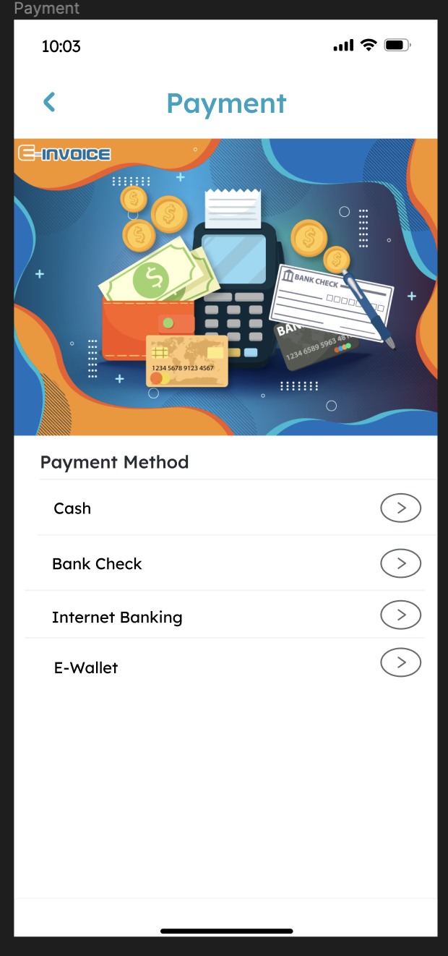
4.3.1. UI Design

Slide 45
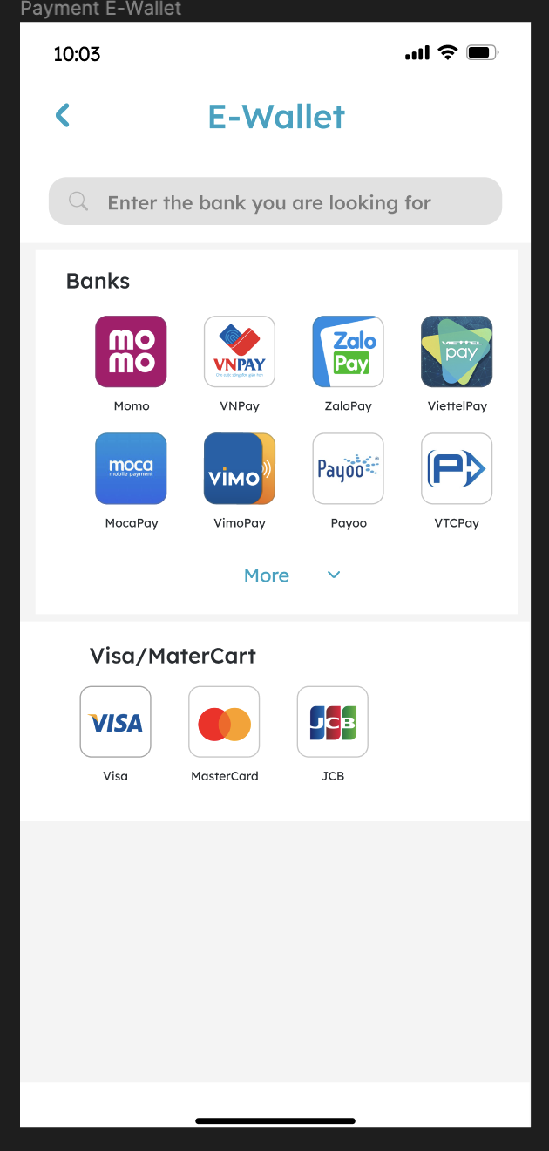
4.3.1. UI Design

Slide 46
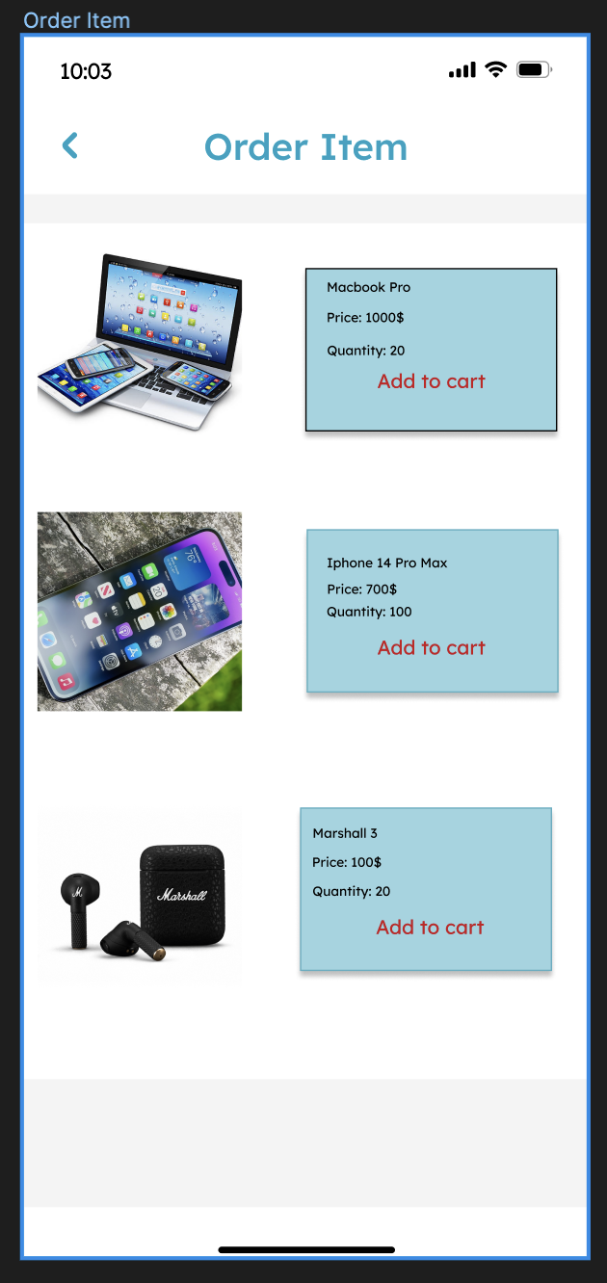
4.3.1. UI Design

Slide 47
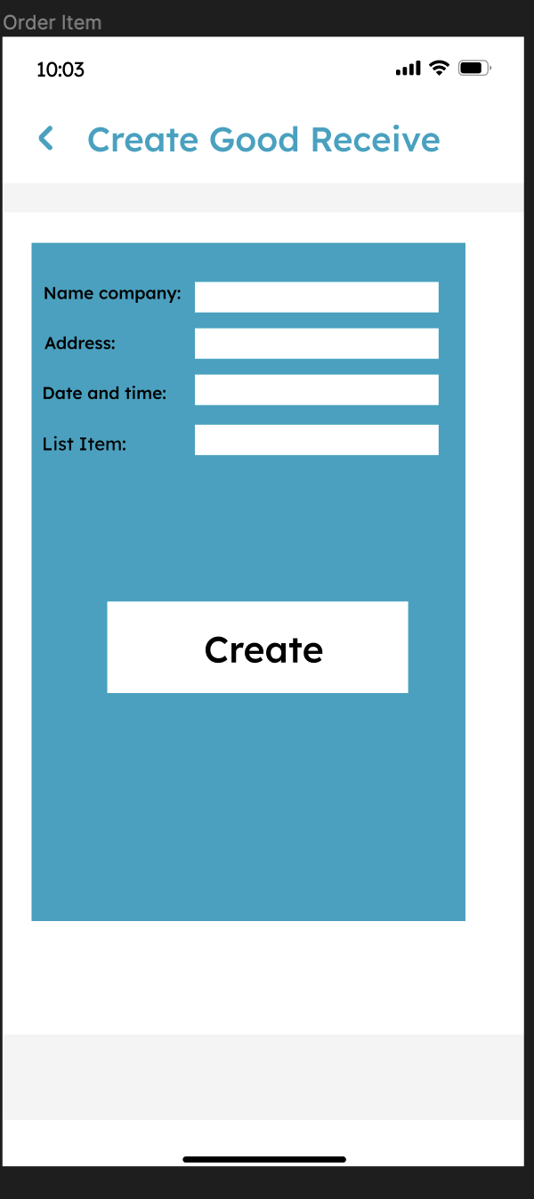
4.3.1. UI Design

Slide 48
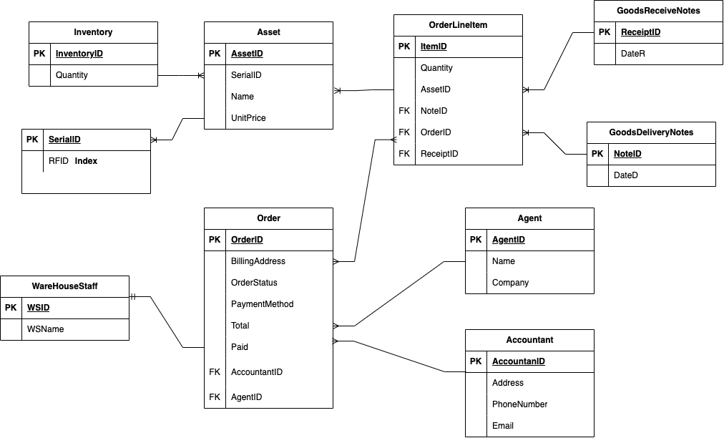
4.3.2. Database Design

Slide 49
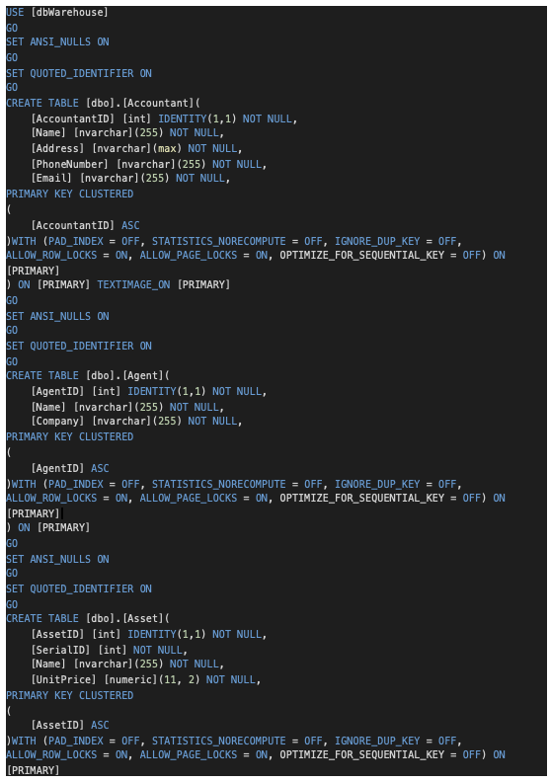
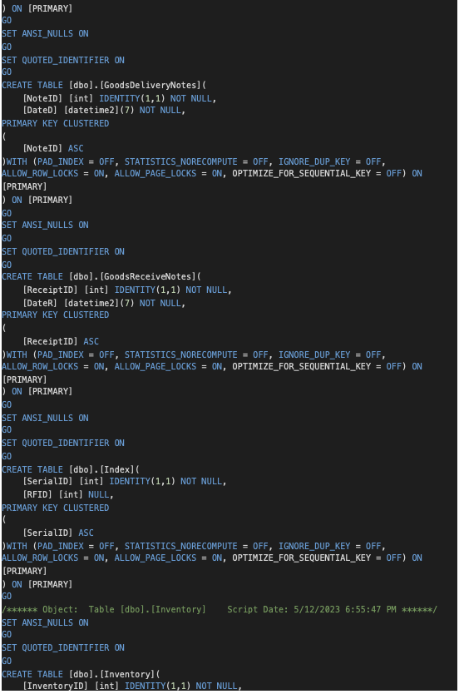
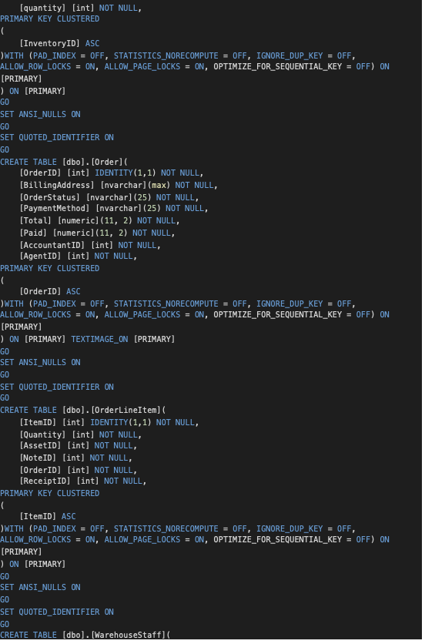
4.3.2. SQL Code

Slide 50
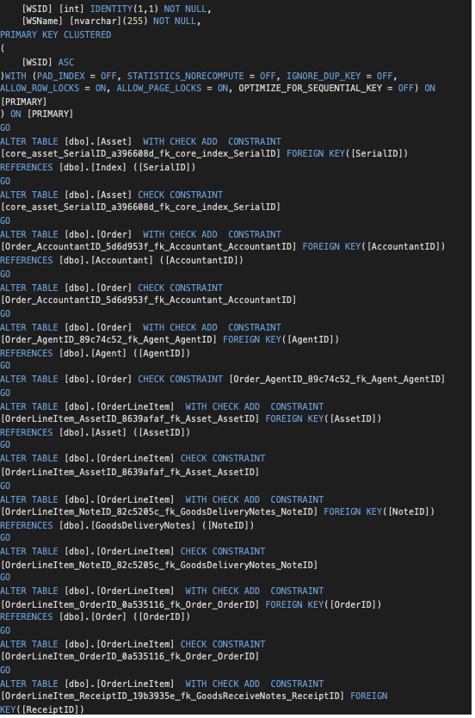
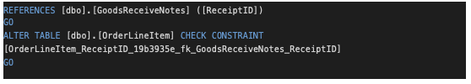
4.3.2. SQL Code

Slide 51
THANKS!
MENU
ANALYSIS
CONTACT
Data ANALYSIS
Do you have any questionS

